Slide 1
Developing a Project Plan Ch. 6, T1
M K Hamirwasia
WILPD

Slide 2
AE/DE/ES/MM/POM ZG523-Merged
Project Management
Lecture No. 7

Slide 3
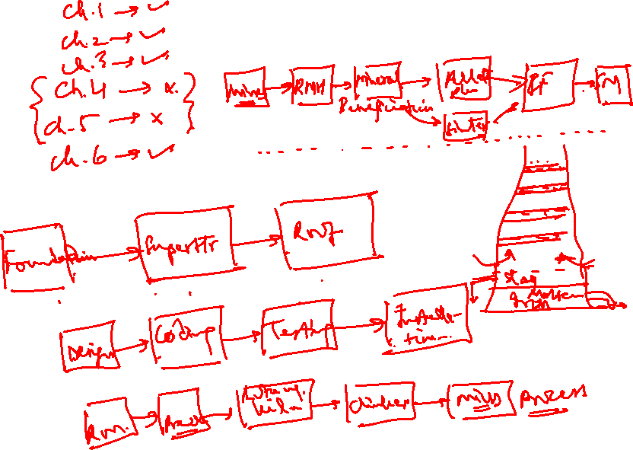

Slide 4
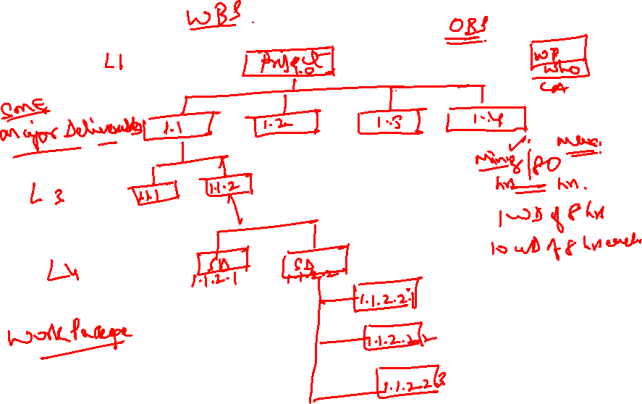

Slide 5
Developing a Project Plan
The Project Network
  A flow chart that graphically depicts the sequence, interdependencies, and start and finish times of the project job plan of activities that is the critical path through the network.
    Provides the basis for scheduling labor and equipment.
    Enhances communication among project participants.
    Provides an estimate of the project’s duration.
    Provides a basis for budgeting cash flows.
    Identifies activities that are critical.
    Highlights activities that are “critical” and can not be delayed.
    Helps managers get and stay on plan.

Slide 6
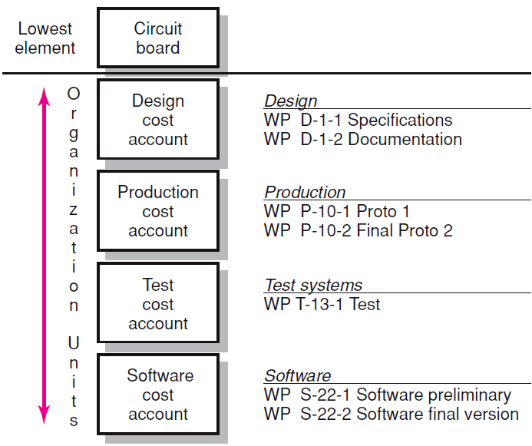
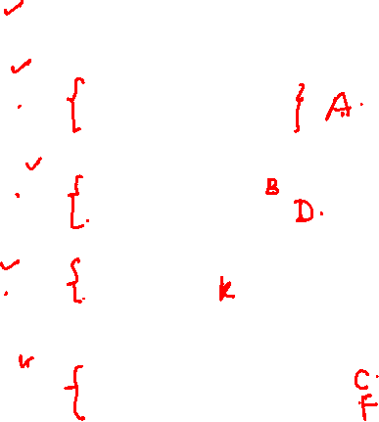
WBS/Work Package to Network WBS Work

Slide 7
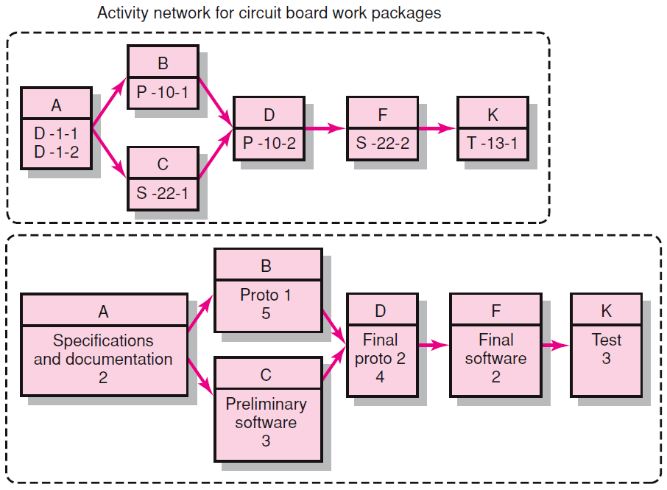
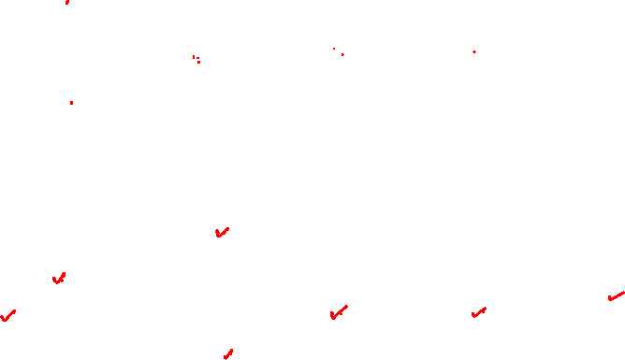
WBS/Work Package to Network (cont’d)

Slide 8
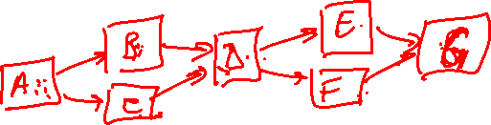
Constructing a Project Network
Terminology
  Activity: an element of the project that requires time. It is the smallest unit of work effort consuming both time and resources.
  Merge Activity: an activity that has two or more preceding activities on which it depends.
  Parallel (Concurrent) Activities: Activities that can occur independently and, if desired, not at the same time.
  Path: a sequence of connected, dependent activities.

Slide 9
Terminology
  Critical path: the longest path through the activity network that allows for the completion of all project-related activities; the shortest expected time in which the entire project can be completed. Delays on the critical path will delay completion of the entire project.
  Event: the point at which one or more activities are to be completed and one or more other activities are to begin. It does not consume time or resources.
  Burst Activity: an activity that has more than one activity immediately following it (more than one dependency arrow flowing from it).

Slide 10
Constructing a Project Network (cont’d)
Two Approaches
  Activity-on-Node (AON)
    Uses a node to depict an activity
  Activity-on-Arrow (AOA)
    Uses an arrow to depict an activity

Slide 11
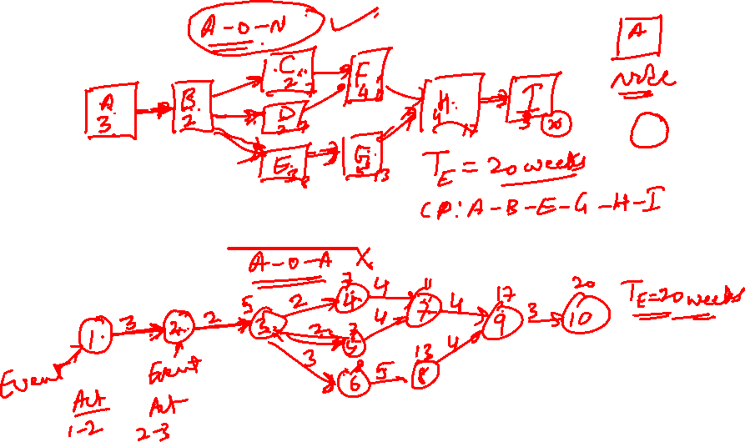

Slide 12
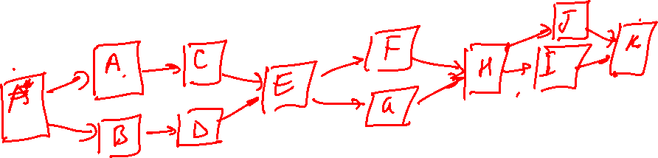

Slide 13
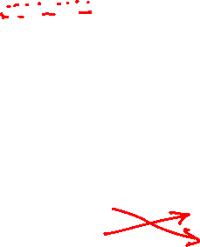
Basic Rules to Follow in Developing
Project Networks
Networks typically flow from left to right.
An activity cannot begin until all preceding connected activities are complete.
Arrows indicate precedence and flow
and can cross over each other.
Each activity must have a unique identify number that is greater than any of its predecessor activities.
Looping is not allowed.
Conditional statements are not allowed.
Use common start and stop nodes.

Slide 14
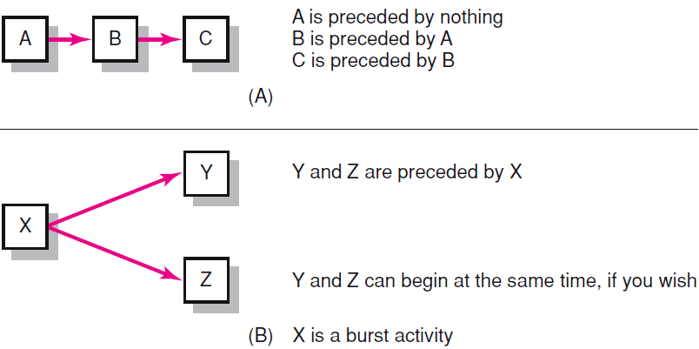
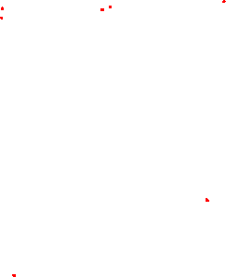

Activity-on-Node Fundamentals

Slide 15
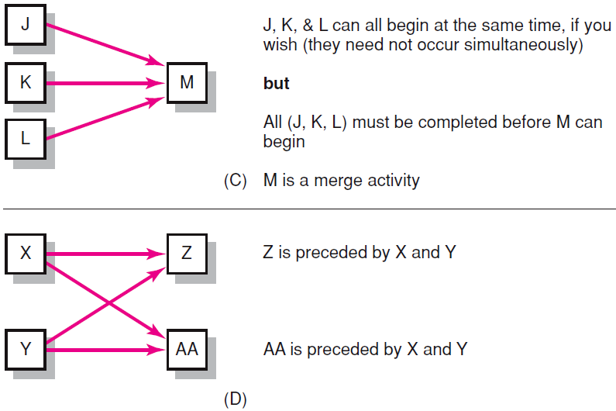
Activity-on-Node Fundamentals (cont’d)

Slide 16
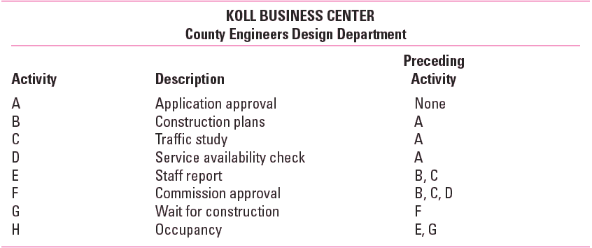
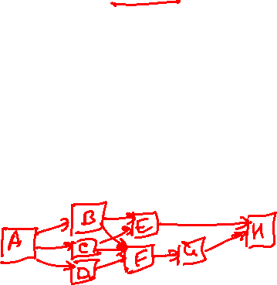
Network Information

Slide 17
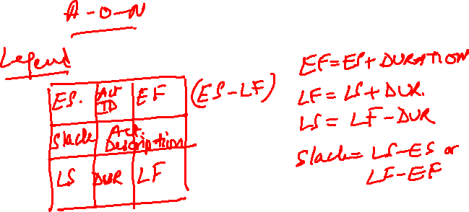

Slide 18
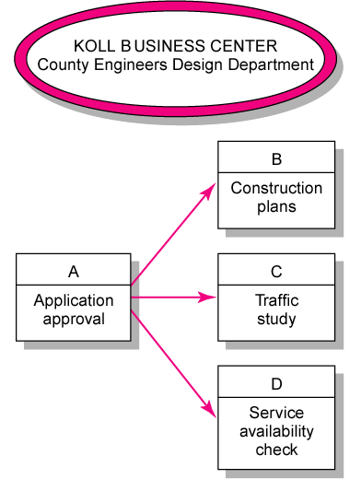
Koll Business Center—Partial Network

Slide 19
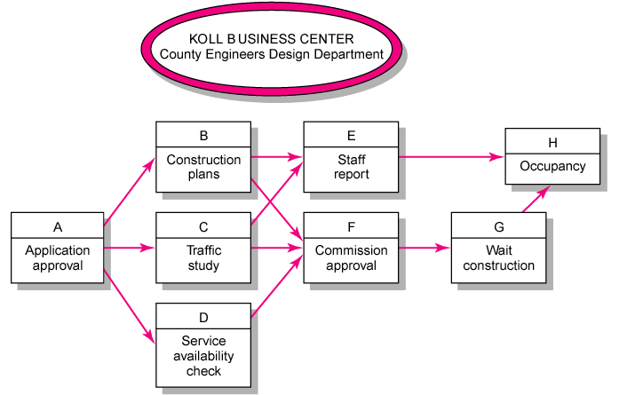
Koll Business Center—Complete Network

Slide 20
Network Computation Process
Forward Pass—Earliest Times
  How soon can the activity start? (early start—ES)
  How soon can the activity finish? (early finish—EF)
  How soon can the project finish? (expected time—ET)
Backward Pass—Latest Times
  How late can the activity start? (late start—LS)
  How late can the activity finish? (late finish—LF)
  Which activities represent the critical path?
  How long can activity be delayed? (slack or float—SL)

Slide 21
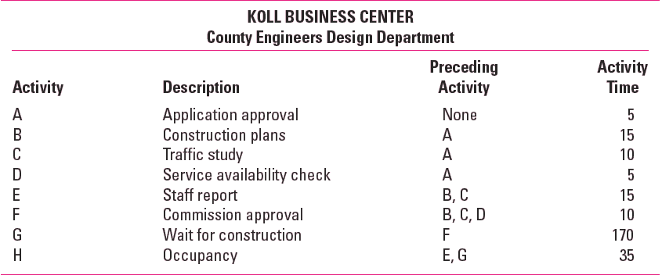

Network Information

Slide 22
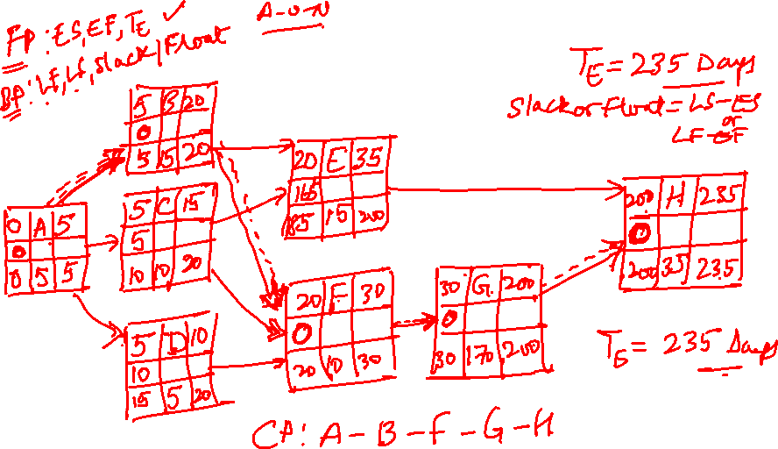

Slide 23
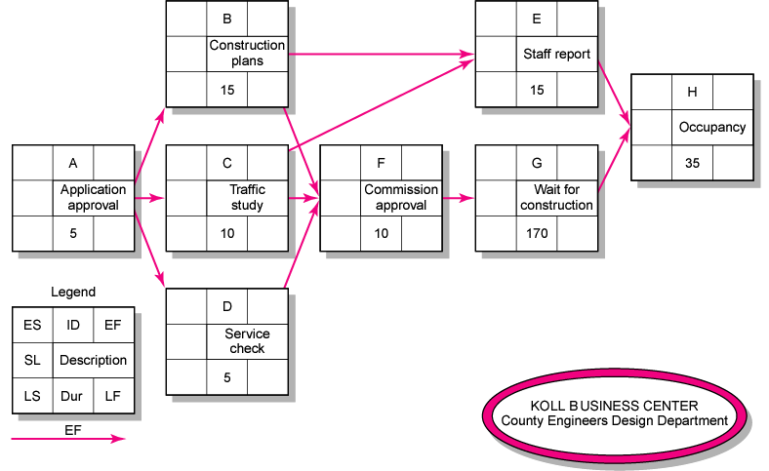
Activity-on-Node Network

Slide 24
Forward Pass Computation
Add activity times along each path in the network (ES + Duration = EF).
Carry the early finish (EF) to the next activity where it becomes its early start (ES) unless…
The next succeeding activity is a merge activity, in which case the largest EF of all preceding activities is selected.

Slide 25
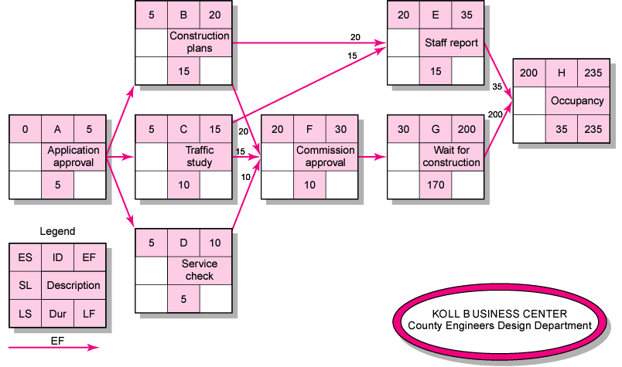
Activity-on-Node Network Forward Pass

Slide 26
Backward Pass Computation
Subtract activity times along each path in the network (LF - Duration = LS).
Carry the late start (LS) to the next activity where it becomes its late finish (LF) unless
The next succeeding activity is a burst activity, in which case the smallest LF of all preceding activities is selected.

Slide 27
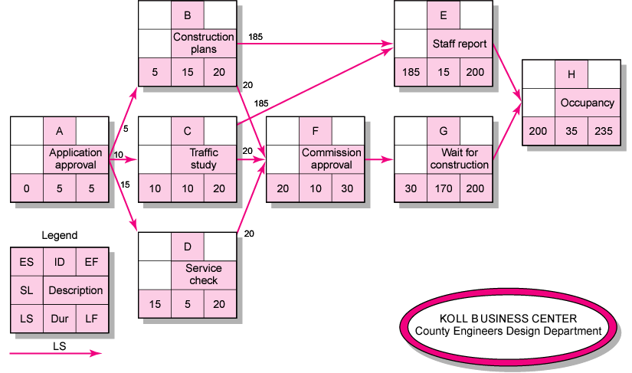
Activity-on-Node Network Backward Pass

Slide 28
Determining Slack (or Float)
Total Slack
The amount of time an activity can be delayed and not delay the project
Free Slack
The amount of time an activity can be delayed without delaying any immediately following activity
Sensitivity
  Reflects the likelihood the original critical path(s) will change once the project is initiated.
  Insensitive and Sensitive network

Slide 29
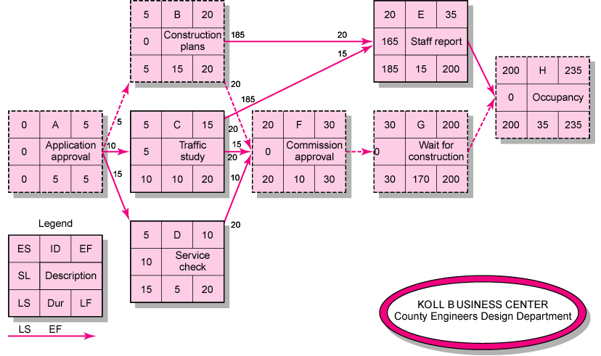
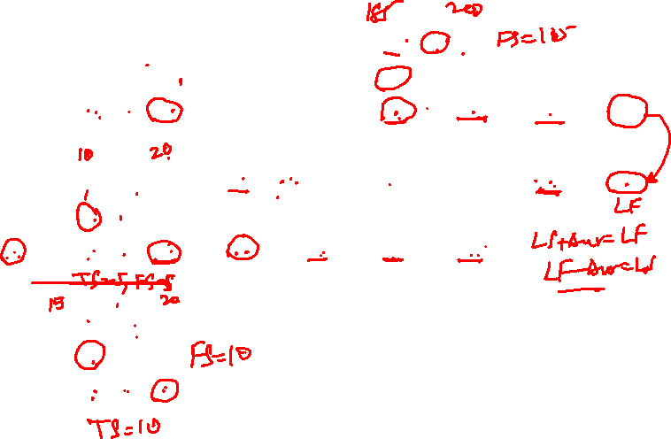
Activity-on-Node Network with Slack

Slide 30
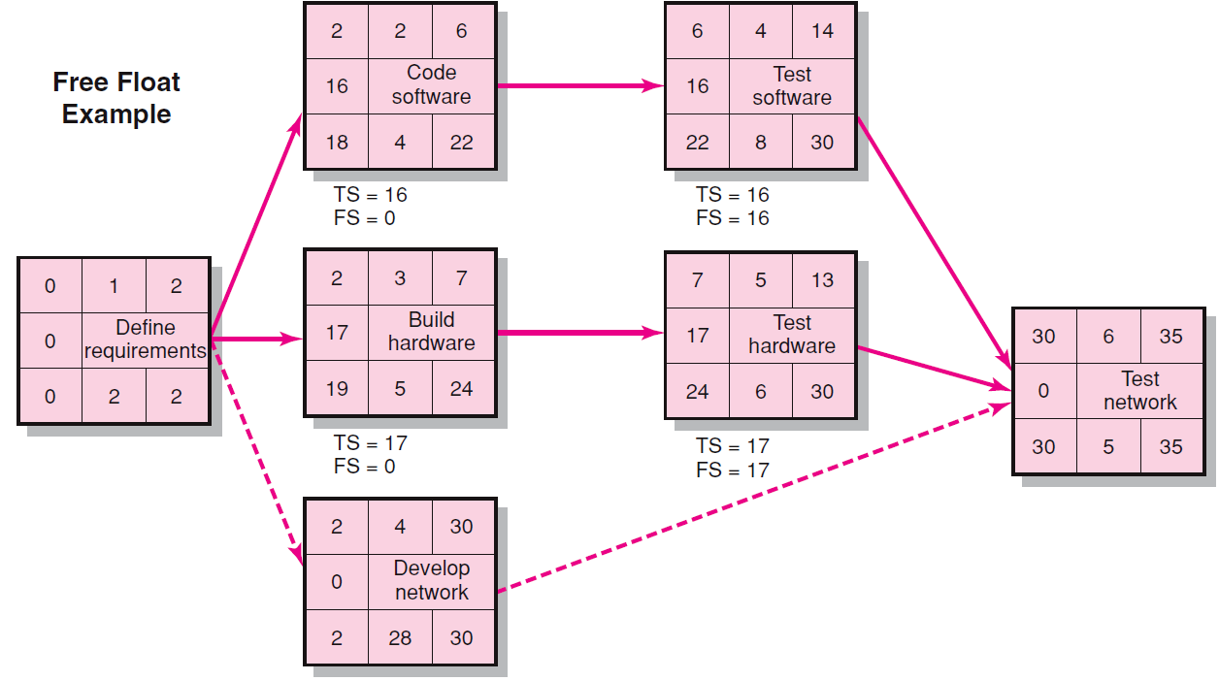
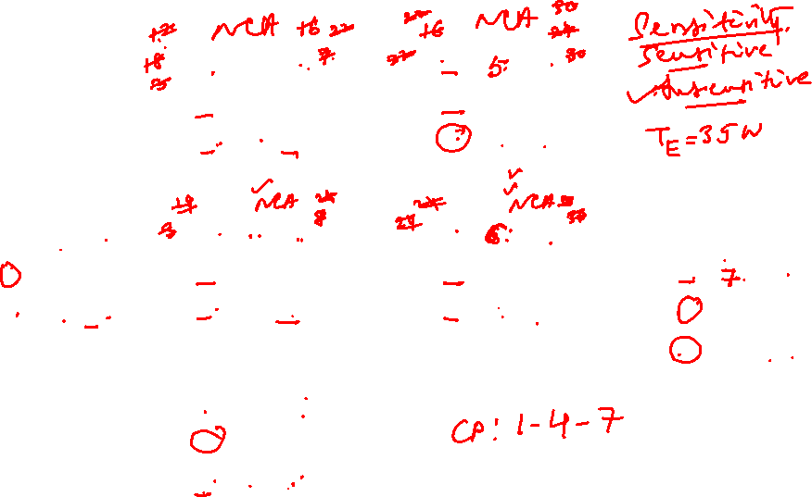
Free Slack Example

Slide 31
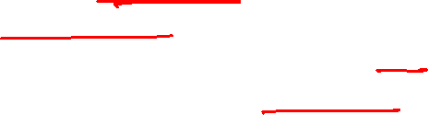
Exercise
1. You have signed a contract to build a garage for the Simpsons. You will receive a $500 bonus for completing the project within 15 working days. The contract also contains a penalty clause in which you will lose $100 for each day the project takes longer than 15 working days.
Draw a project network given the information below. Complete the forward and backward pass, compute the activity slack, and identify the critical path.
Do you expect to receive a bonus or a penalty on this project?

Slide 32
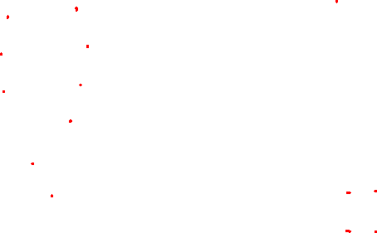
Exercise
ID Description Predecessor Time (days)
A Pour Foundation None 3
B Erect Frame A 4
C Roof B 4
D Windows B 1
E Doors B 1
F Electrical B 3
G Rough-in-frame C, D, E, F 2
H Door Opener E, F 1
I Paint G, H 2
J Cleanup I 1

Slide 33
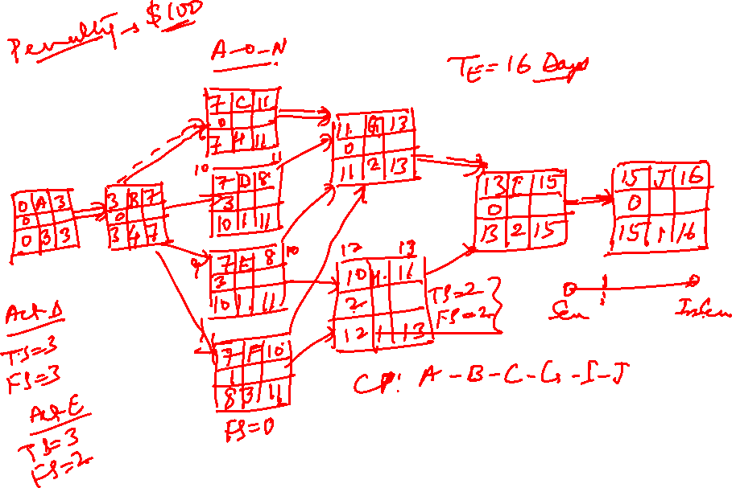

Slide 34
Exercise
Legend
Early Start | Activity ID | Early Finish
Slack | Description
Late Start | Duration | Late Finish

Slide 35
Exercise
0F
7 | C | 11
0 | Rf
7 | 4 | 11
0 | A | 3
0 | Pr Fn
0 | 3 | 3
3 | B |  | 7
0 | Er Fr
3 | 4 | 7
7 | D |  | 8
3 | Win
10 | 1 | 11
11 | G | 13
0 | RiF
11 | 2 |  | 13
13 | I | 15
0 | Pt
13 | 2 | 15
15 | J | 16
0 | Cp
15 | 1 |  | 16
7 | E |  | 8
3 | Drs
10 | 1 | 11
10 | H | 11
2 | D O
12 | 1 | 13
CP: A-B-C-G-I-J
FS (H) = 2
7 | F | 10
1 | El
8 | 3 | 11
T_{E} = 16 Days

Slide 36
Exercise
2. You are creating a customer database for the Modesto Nuts minor league baseball team. Draw a project network given the information below. Complete the forward and backward pass, compute activity slack, and identify the critical path.
How long will this project take? How sensitive is the network schedule? Calculate the free slack and total slack for all noncritical activities.

Slide 37
Exercise
ID Description Predecessor Time (days)
A Systems Design None 2
B Subsystem A Design A 1
C Subsystem B Design A 1
D Subsystem C Design A 1
E Program A B 2
F Program B C 2
G Program C D 2
H Subsystem A Test E 1
I Subsystem B Test F 1
J Subsystem C Test G 1
K Integration H, I, J 2
L Integration Test K 1

Slide 38
Exercise
2 | B | 3
0 | SSAD
2 | 1 | 3
3 | E | 5
0 | PRA
3 | 2 | 5
5 | H | 6
0 | SSAT
5 | 1 | 6
T_{E} = 9 Days
3 Critical Paths
Very Sensitive Network
0 | A | 2
0 | SD
0 | 2 | 2
2 | C | 3
0 | SSBD
2 | 1 | 3
3 | F | 5
0 | PRB
3 | 2 | 5
5 | I | 6
0 | SSBT
5 | 1 | 6
6 | K | 8
0 | Intgrn
6 | 2 | 8
8 | L | 9
0 | InTst
8 | 1 | 9
2 | D | 3
0 | SSCD
2 | 1 | 3
3 | G | 5
0 | PRC
3 | 2 | 5
5 | J | 6
0 | SSCT
5 | 1 | 6
No Free Slack

Slide 39
Project Management
Thank You!

